Slide 1

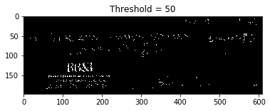
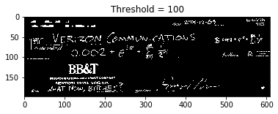
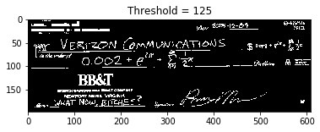
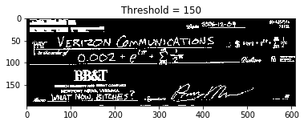
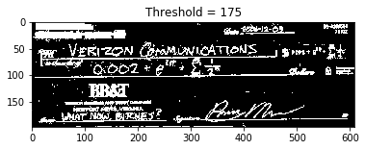
Rene L. Principe Jr.
2015-04622
Dr. Maricor Soriano
Applied Physics 186
Activity 7 : Image Segmentation
Figure 3. This portrait shot used an incandescent lighting which is why the image appears to be yellowish.

Slide 2
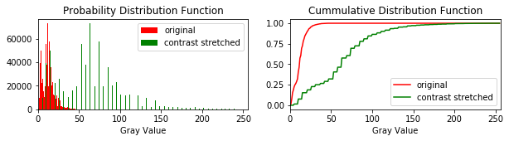
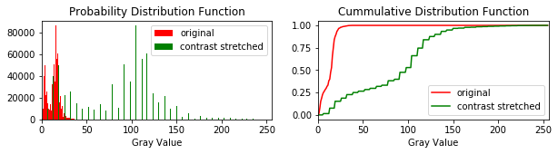
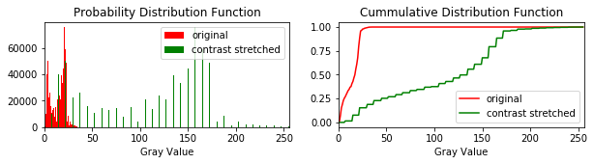
Red
Green
Blue
Figure 4. Statistical Properties of each image color channel was significantly altered after performing the contrast stretching algorithm on the panoramic beach photo,
Shown in Fig. 4 are the histogram manipulation plots across RGB channels for the panoramic beach image in Fig. 2. The original probability distribution function (PDF) of the image per channel is cramped on gray values less than 50, which explains its dark appearance. The corresponding cumulative distribution function (CDF) has a very steep slope at start and flatlined afterwards. I’ve shown in the last activity that linearly behaving CDFs were visually ideal. Hence, performing contrast stretching resulted to the green markers on the plots, which implies a well stretched PDF across all gray values, and a CDF that is steadily increasing and more linear than the original. The same process was employed on the dark portion of Ambuklao Dam in Fig. 1. The resulting contrast stretched channels were stacked to reconstruct the color images and the results are shown in Fig. 5.
For the gray world algorithm, each channel was divided on the channel’s average gray value, hence the term “gray world” [1]. Since the values computed after the gray averaging were not necessarily from 0-1, I normalized the values to avoid clippings. The process is pretty straight forward and the results of the algorithm for the panoramic beach photo and a section in Ambuklao dam photo were shown in Fig. 5. Both algorithms show visually promising results. Colors were much more vibrant and appropriate to the scenery. Although the panoramic beach shot were white balanced differently by the two algorithms, the colors were still photorealistic. The ROI in the Ambuklao dam photo turned out to be covered with green trees and a cemented portion on the interface was present. Ridging details were in fact stairs towards the water shed. From completely indiscernible ROIs, the algorithms returned images which are photorealistic and discernible.
The last algorithm I used is the white patch algorithm, where we divide each chanel with the white RGB values from a known white object present in the image [1].

Slide 3
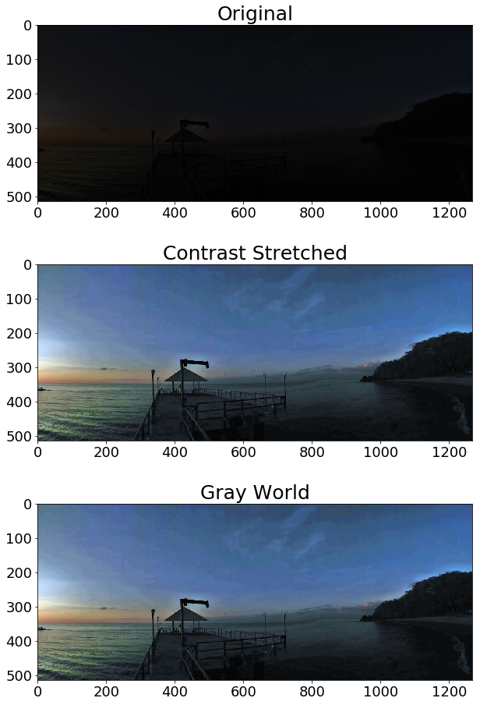
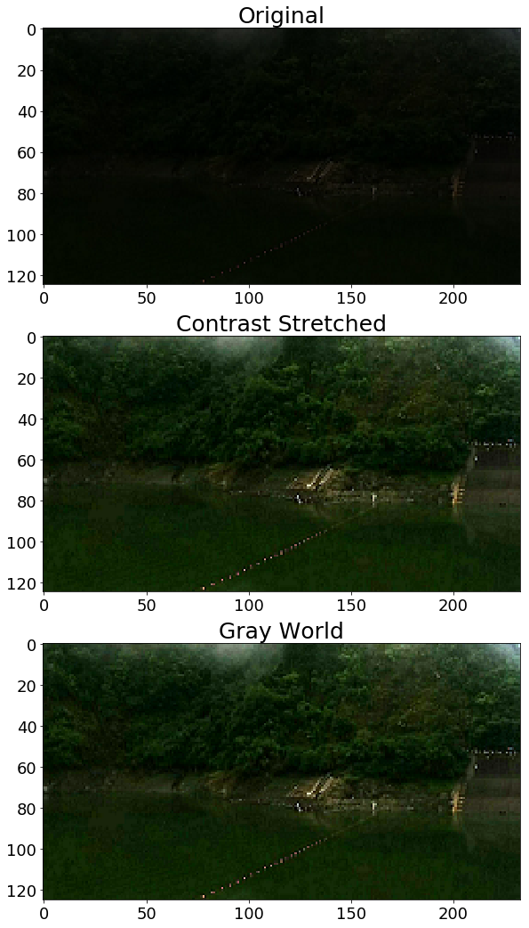
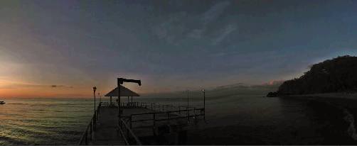
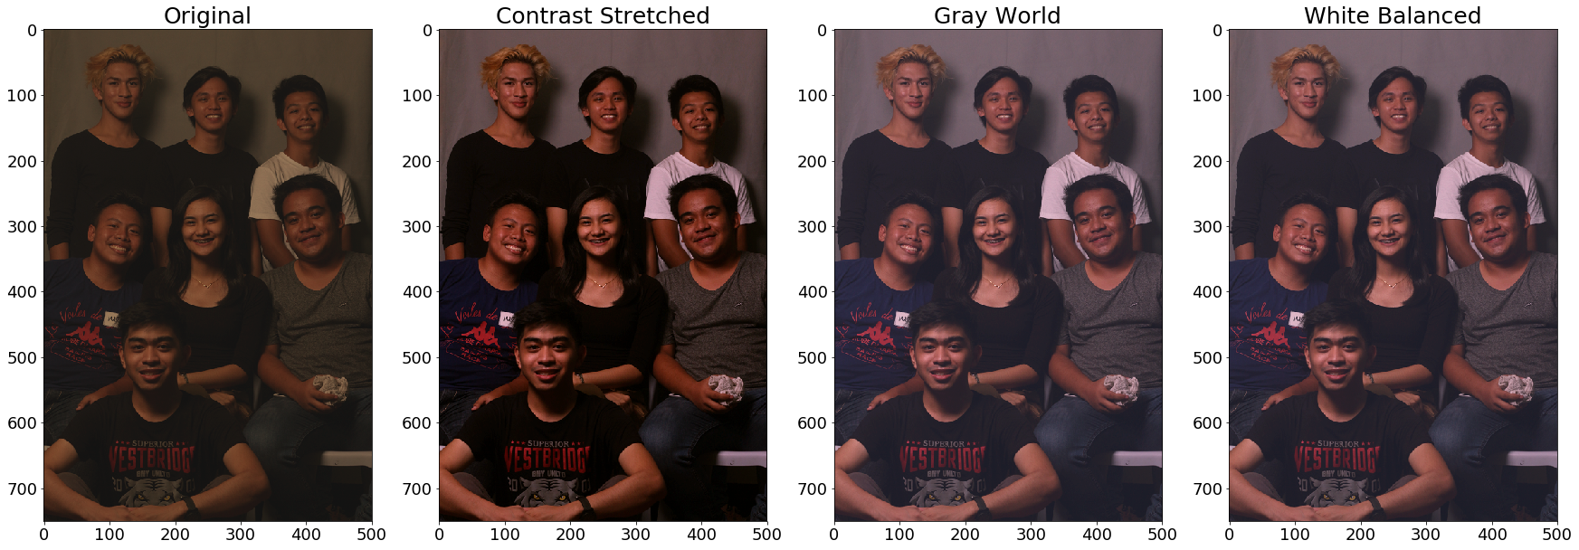
Figure 5. Contrast stretching and gray world algortihms were performed on the indiscernible ROIs of a beach photo and the portion of Ambuklao Dam and the results returned a qualitatively realistic color story of the image.
Figure 6. Comparison of the images recovered by various white balancing algorithms on the portrait shot which has an innate yellowish tint due to the incandescent lighting.
Since there was no white object on the scene for the first two images, I added the portrait shot in Fig. 3 such that I can implement the white patch algorithm. In this image, I used the white shirt of my friend as the white object. The white patch algorithm results, in comparison with the two other algorithms, were shown all in Fig. 6. Each algorithm brings a different “flavor” to image, and I guess subjectivity/preference shall be the basis as to which algorithm performed the best.
I’d give myself a 10/10 in this activity. I got the results on the first try since I’ve been doing this in my image processing research. The only drawback in this activity is not having a quantitative measure as to how correct our white balanced image is. Nevertheless, the fact that an indiscernible image was brought back to (colorful) life is quite awesome.
Self Evaluation:

